Slide 1
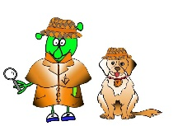
Spanish Y4 Stage 2 Autumn 2:Town and shops.
Language Detectives’ Memory Bank of “Town and Shops”
Noun Bank
El café- the cafe
El cine the cinema
El restaurante – the restaurant
El supermercado- the supermarket
El estadio – the stadium
La carnicería- the butchers
La panadería- the bakers
La farmacia- the chemist
La escuela – the school
Question and Answer Bank
¿Dónde está….?- Where is ….?
Aquí está… - Here is ……
Sound spelling
“qui”
“cuela”

