Slide 1

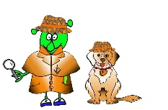

Spanish Y4 Stage 2 Spring 2: parts of the body
Language Detectives’ Memory Bank of “parts of the body”
Grammar
The plural word for “the” in Spanish is “los” (el) and “las” (la).
Nouns Bank
El pie– the foot
Los pies - the feet
La pierna - the leg
Las piernas - the legs
El brazo – the arm
Los brazos - the arms
El hombro – the shoulder
Los hombros – the shoulders
La cabeza – the head
La rodilla - the knee
Las rodillas - the knees
Command Bank (verbs)
Mueve - move
Siente - feel
Tócate - touch
Levanta – lift
Baja – lower
Quédate quieto – stand still.
Gira – Turn
Estira – Stretch
Grammar
We say and write colours as adjectives after the noun in Spanish.
Grammar
When we say and write colours as adjectives after the noun in Spanish, we add –s or –es.
Sound spelling
“ll”
“ie”
“qu”
“z”

