Slide 1
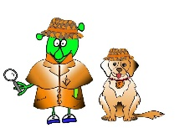
Spanish Y4 Stage 2 Autumn 1: Classroom objects and asking for an item .
Language Detectives’ Memory Bank: Classroom objects and asking for an item.
Noun Bank
La clase- the classroom
La mochila – the rucksack
El lápiz - the pencil
El bolígrafo - the pen
El libro - the book
Los lápices de colores – coloured pencils
La goma - the eraser
La mesa- the table
La silla- the chair
La regla- the ruler
Las tijeras – the scissors
El pegamento – the gluestick
Sound spelling
“iz”
“j”
“ces”
Grammar Bank
To say “I have” in Spanish we use “tengo..” (I have).
To say the negative ( I have not..) we use
“no tengo…”.
Question and Answer Bank
¿Tienes?…….? – Have you got ……?
Tengo …… - I have ……
No tengo …- I have not ……

