Slide 2

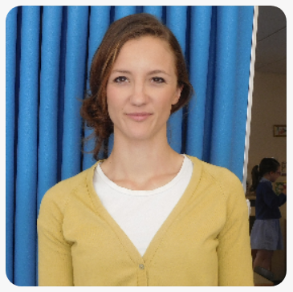
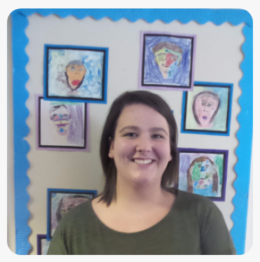
Welcome to Twiss Green
We are Mrs Durr and Miss Nunnerley and we will be your teachers in September.
Let us tell you what a day at Twiss Green looks like.
Mrs Durr
Miss Nunnerley

Slide 3

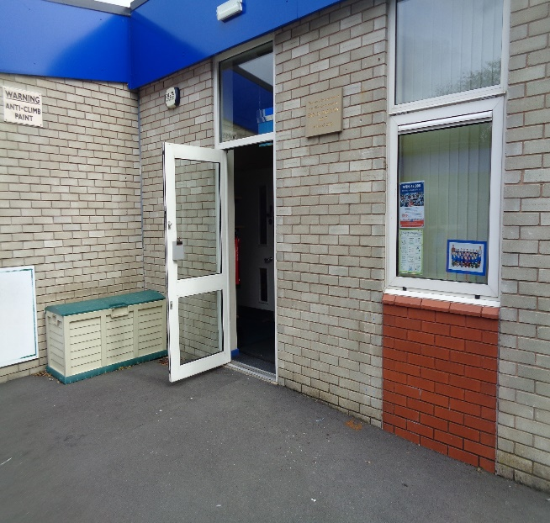
Good morning!
When you come to school in the morning, you need to walk through the playground and find our classroom door.

Slide 4
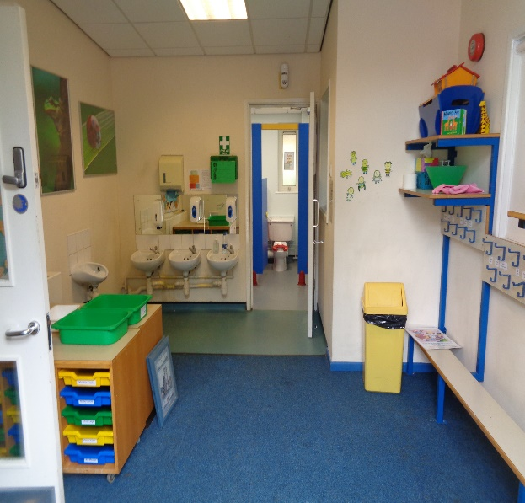
When you come into the classroom, you will need to take off your coat and hang it on your peg. Each child in our class has their own peg. You will have your own tray with your name on you can put your belongings in there too!
Insert a photo showing the children’s coat pegs.
Insert a photo of yourself here.

Slide 5

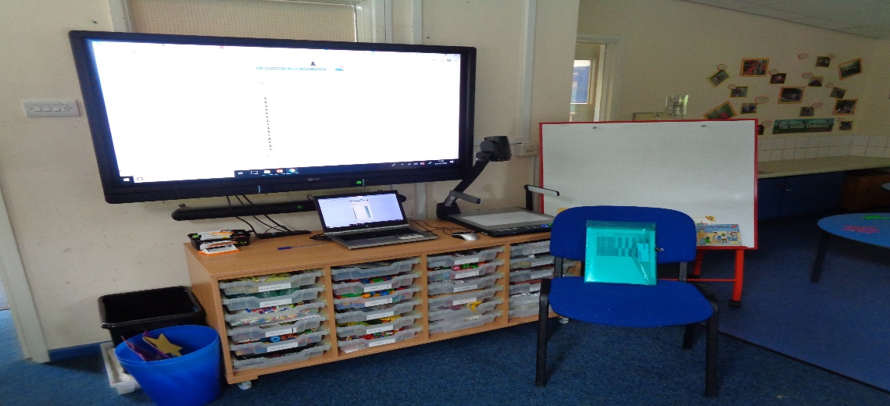
Our next job is to do the register. We sit quietly on the carpet for this special job. I will read out a list of all the children in our class to see who is in school today.
Insert a photo of yourself here.
Insert a photo of register time.

Slide 6
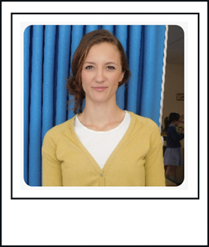
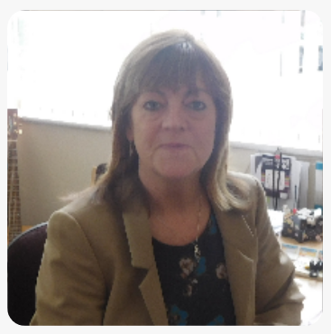
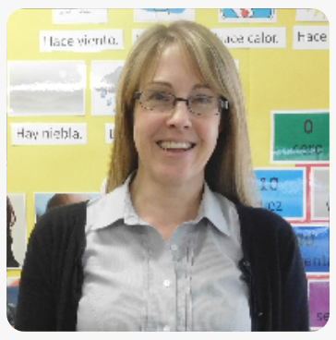
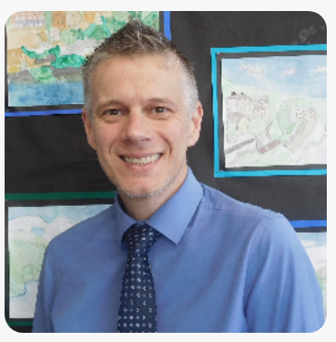
At Twiss Green we have our assemblies in the school hall.
In assembly we listen to stories and sing songs.
It’s a little different this year. We will have our school assembly in class on the computer. These are some of the teachers who you might see during assembly.
Insert a photo of yourself here.
Miss McGann
Mrs Fuller
Mr Wood

Slide 7
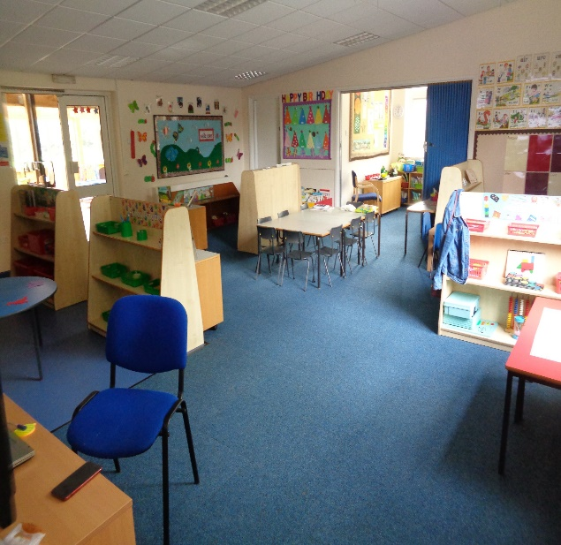
When we come back to the classroom, we will have a talk about what we will be doing for the rest of the day.
There are lots of things for you to explore – let’s take a look!
Insert a photo which shows you in the classroom.
Insert a photo of yourself here.

Slide 8

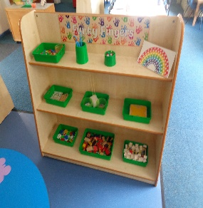
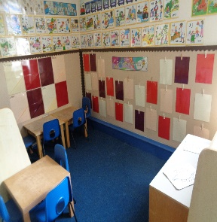
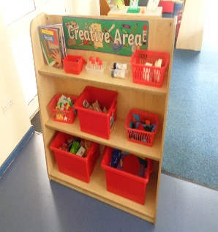
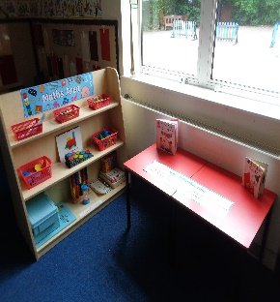
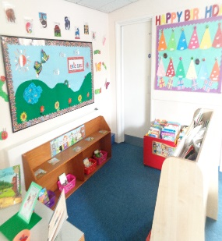
Insert a photo which shows a different area or resource.
Insert a photo which shows a different area or resource.
Insert a photo which shows a different area or resource.
Insert a photo which shows a different area or resource.
In the classroom, there are lots of things for you to explore and help you with your learning.
Insert a photo which shows a different area or resource.
Insert a photo of yourself here.

Slide 9

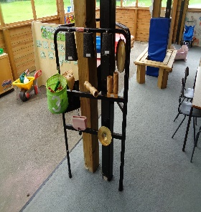
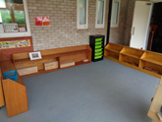
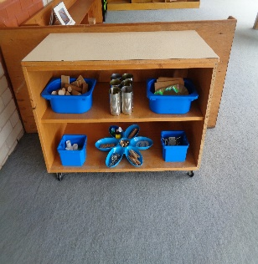
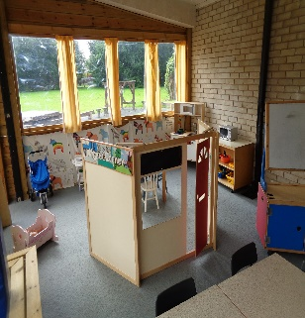
Insert a photo which shows a different area or resource.
Insert a photo which shows a different area or resource.
Insert a photo which shows a different area or resource.
Insert a photo which shows a different area or resource.
There are lots of exciting things for you to explore outside too.
Insert a photo which shows a different area or resource.
Insert a photo of yourself here.

Slide 10
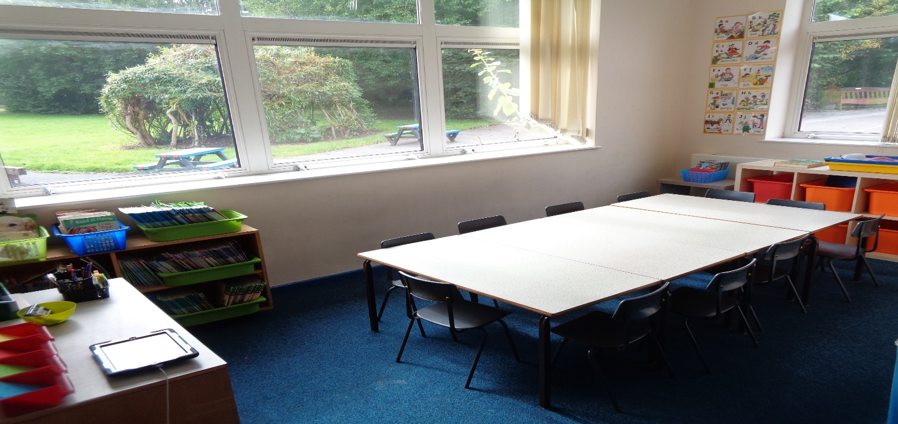
Sometimes, Miss Nunnerley or I might ask you to come and do a special job with us too.
Insert a photo of yourself here.
Insert a photo which shows yourself with a task for children to complete.

Slide 11
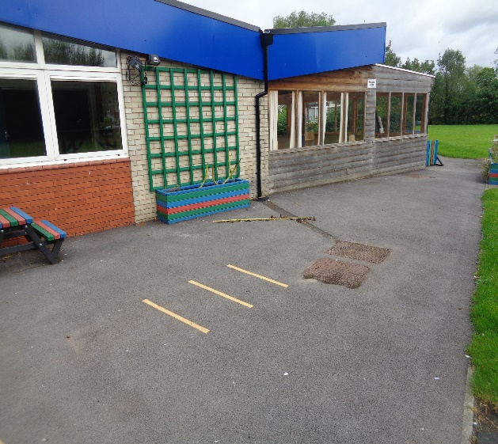
During the day, we sometimes go outside to the playground to play.
We will be playing in a group with some of our other friends either in the mud kitchen and butterfly garden or on the playground.
Insert a photo of yourself here.

Slide 12
After our morning learning time, it is lunchtime.
There are lots of people to help you at lunchtime. We normally go the hall to eat our lunch but for now we will be having it class with myself and Miss Nunnerley.
Insert a photo which shows where the children eat lunch.
Insert a photo of yourself here.

Slide 13
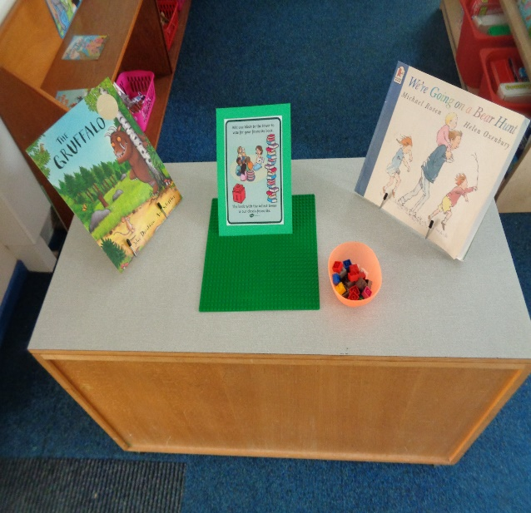
After lunch, we will do the afternoon register and we may share a story or when you’re a little bit older we will start reading workshop.
Insert a photo of song time.
Insert a photo of yourself here.

Slide 14
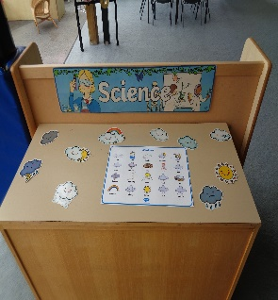
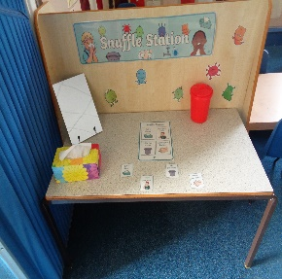
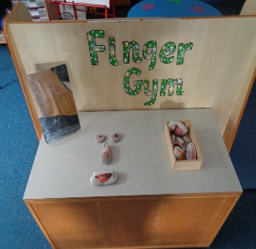
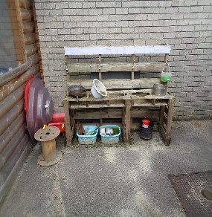
Insert a photo which shows a different area or resource.
Then, it’s back to our exciting learning! Will you play inside or outside?
Insert a photo which shows a different area or resource.
Insert a photo of yourself here.
Insert a photo which shows a different area or resource.
Insert a photo which shows a different area or resource.

Slide 15
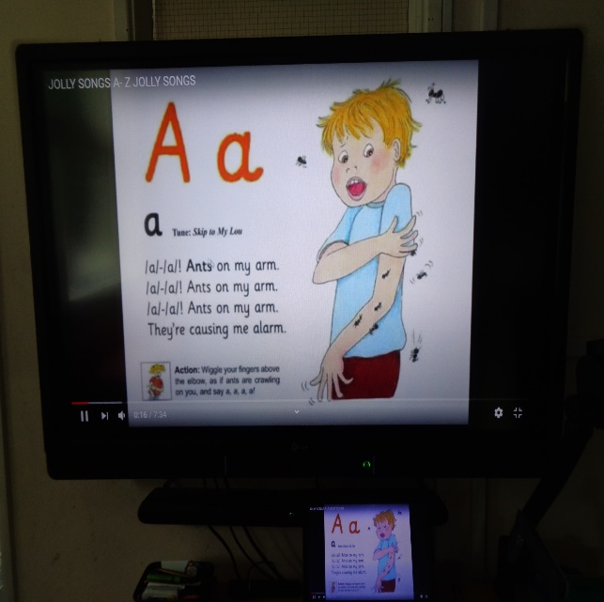
Just before it is time to go home, we sit together on the carpet and talk about all the exciting things we have been up to.
We may have a story or sing some songs.
Insert a photo which shows story time.
Insert a photo of yourself here.

Slide 16

When it is home time, we put on our coats and collect our belongings to take home.
Insert a photo which shows where the children will go home.
Insert a photo of yourself here.

Slide 17
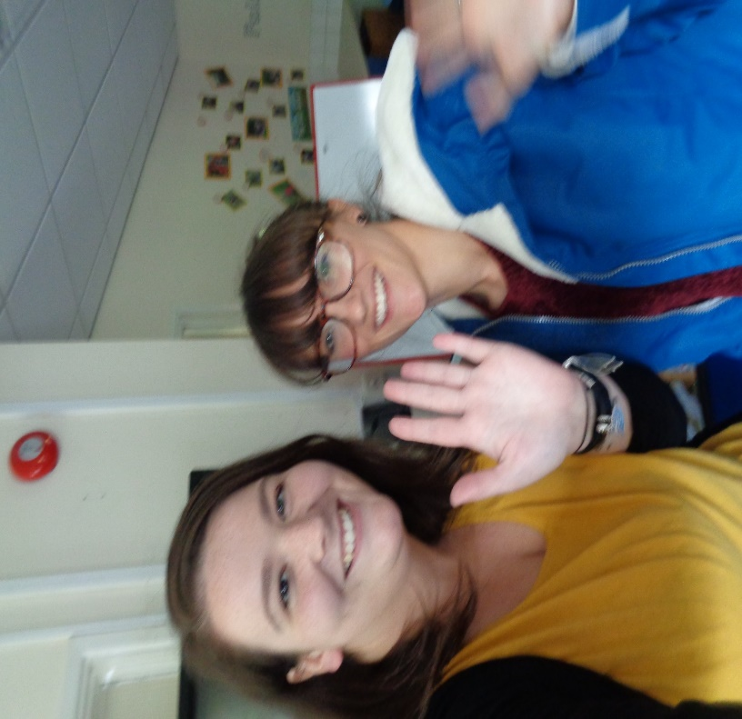
Phew! What busy days at Twiss Green.
We are looking forward to making lots of exciting memories with you.
Mrs Durr & Miss Nunnerley
Insert a photo of yourself and your teaching assistant, waving.

