Slide 1

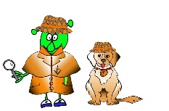

Spanish Y4 Stage 2 Summer 1 Jungle Animals
Language Detectives’ Memory Bank of Jungle Animals
Nouns bank
La selva- the jungle
La jirafa- the giraffe
La serpiente- the snake
El loro - the parrot
El mono - the monkey
El tigre- the tiger
El elefante - the elephant
Grammar
Adjectives agree with the noun they describe. The spelling of the same adjective can change if you are describing a masculine (el) noun or a feminine(la) noun.
Adjectives bank
pequeño/pequeña- small
grande- big
alto/alta- tall
largo/larga - long
travieso/ traviesa - naughty
colorido/colorida- multicoloured
terrible- fierce/frightening
Sound spelling
“jir”
“gre”
“ňo”

