Slide 1
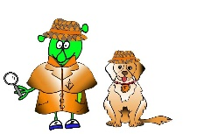
Spanish Y4 Stage 2 Spring 1: Family
Language Detectives’ Memory Bank of Family
Noun Bank
El papá -the dad
El hermano – the brother
El bebé – the baby
El abuelo – the grandad
La mamá - the mum
La hermana – the sister
La abuela- the grandma
Sound spelling
“uela”
“á”
“a”
Grammar
There are two words for “the” in Spanish with singular nouns.
These words are “el” and “la”
Question and Answer Bank
¿Quién eres tú? – Who are you?
Soy ….. – I am …..

