Slide 1
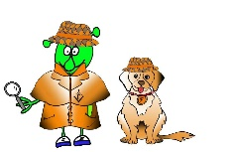
Spanish Y4 Stage 2 Summer 2 –ice creams.
Language Detectives’ Memory Bank of ice creams.
Sound spelling
“vai”
”nilla”
“buesa”
“helado”
Asking for an ice cream phrase bank
Me gustaría – I would like
Un helado- an ice cream
Un helado de chocolate- a chocolate ice cream
Un helado de limón - a lemon ice cream
Un helado de fresa - a strawberry ice cream
Un helado de frambuesa - a raspberry ice cream
Un helado de menta - a mint ice cream
Un helado de vainilla - a vanilla ice cream
Por favor- please

