Slide 1
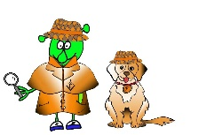
Spanish Y4 Stage 2 Spring 1: Parts of face
Language Detectives’ Memory Bank of “parts of the face”.
Noun Bank
La nariz – the nose
El pelo- the hair
Los ojos- the eyes
La cabeza- the head
La boca- the mouth
Las orejas – the ears
Sound spelling
qué
jas
riz
Grammar
There are two words for “the” in Spanish with plural nouns.
These words are “los” and “las”.
We use los with masculine nouns (el ) and las with feminine nouns (la).
Question and Answer Bank
¿De qué color es….? – What colour is ….?
¿ De qué color son ….?- What colour are….?
Es …. - It is
Son….- They are

